Slide 1
Debugging Clion demo

Slide 2
File I/O and strings
Based on materials developed by professor Joshua Fox

Slide 3
First, strings
A string is an array of characters:
char someString[] = "I’m a string!";
char otherString[] = "Bob";
char stillAString[] = "bm3opd8$!@#09fmeadof";
const char *alsoAString = "Hello, world";
char *notConstButAString = otherString;
string lolMeToo = “Also a string! (More than a char * though).";

Slide 4
A string is an array of characters, PLUS 1 more
char someData[] = "Bob";
The “length of the string” is 3.
The “size of someData” is actually 4 characters.
WTF is this thing and how did it get in my string?!
B
o
b
\0

Slide 5
Meet \0, the null terminator
Technically called NUL
\0 is used to indicate the end of the string
Automatically added to string literals
"Bob" // Really Bob\0
"Dinosaur" // Really Dinosaur\0
"Batman\0" // Really Batman\0\0

Slide 6
Characters get special treatment…
// Printing an array? Need a count.
void Foo(const float *data, int floatCount)
{
for (int i = 0; i < floatCount; i++)
cout << data[i];
}
// Printing an array of CHARACTERS?
// Probably null-terminated, no need.
void Foo(const char *name)
{
// Stops at null terminator… if present.
cout << name;
}
Probably? Go on…

Slide 7
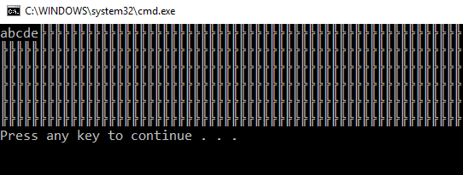
What if there isn’t a terminating character?
char someValues[5];
someValues[0] = 'a';
someValues[1] = 'b';
someValues[2] = 'c';
someValues[3] = 'd';
someValues[4] = 'e';
// No problems
for (int i = 0; i < 5; i++)
cout << someValues[i];
// Very likely to have problems
cout << someValues << endl;
Keeps printing until a 0, or NUL in memory is reached.

Slide 8
Old-School strings are a pain…
Nope… at least not with raw pointers. The string class does allow for this (thanks to operator overloading!)
char hero[] = "Batman";
char sidekick[] = "Robin";
// Combine into “Batman and Robin”
char heroTeam[] = hero + " and " + sidekick; // #nope
1. Create new array with a size equal to:
(length of hero) + (length of " and ") + (length of sidekick)
PLUS 1 for the null terminator
2. Copy hero into string.
3. Copy “ and ” into string.
4. Copy sidekick into string.
5. Set last character to '\0'
That’s… a lot of work
We’ve seen this type of thing before
This work must be done SOMEWHERE… even if it’s not by us

Slide 9
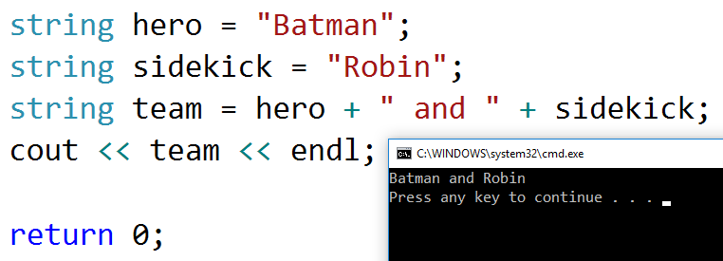
string classes to the rescue
So… why even use older strings character arrays?
Lots of things use similar concepts – memory allocation, copying arrays of data, etc
Understand those, and you can apply it in many ways
You may work with some code that doesn’t have a std::string class as an option
You’ll have to figure out how to make it work

Slide 10
File Input and Output
Virtually all data in computer applications is read from/stored in files
Even “cloud” data – this is just a file on someone else’s computer (Google, Microsoft, Facebook, etc)
All files are made up of collections of basic data types – ints, floats, characters, etc
Data can be represented in text or binary
Each with their own advantages/drawbacks

Slide 11
File Structures
All files have SOME structure
Even if you don’t know it, someone does
Understanding that structure allows you do something with that file (read it, edit it, create new files of that type)
Some files are very simple and straightforward, others… not so much

Slide 12
Why use files for data?
Simple applications can have all of their data “hard-coded”
Names of variables, numbers of loop iterations, etc all stored in a source file
Written by a programmer
Many applications are data-driven
Uses external sources of information to define behavior
Data File 0
Output to user
Your program
Data File 1
Output to other files
Data File 2

Slide 13
Scenario: Address Book / Contact List
Do you store all of the information for a contact list in source files?
How many entries should there be?
How would you possibly know in advance what those are?
A program like that should allow for adding/deleting entries
Ew, no. We’re not savages.
ContactList contacts;
contacts.AddEntry("Batman", "42 Batcave Lane", "555-BATS");
contacts.AddEntry("Superman", "86 Fortress o' Solitude Way", "555-2263");
// etc...
Unless, of course, you want your program to do exactly this…
Surely there’s a better way…
// Read some data from a file…
contacts.AddEntry(nameFromFile, addressFromFile, phoneNumberFromFile);
You, the programmer, don’t have to know what these values are

Slide 14
File Basics
Every file has three things in common:
Directory – In which folder/directory is this file located?
Filename – The name of the file
Extension – What type of file is this?
(Typically hints at: how is this file’s data structured?)
Combine all three together for the full path of the file

Slide 15
Complete File Path
D:\Documents\PG2\Lecture\File IO.ppt
Directory
Filename
Extension
C:\ThisIs_My_OddAnd.Long.File_nAmE.xyzqmwe
Directory
Filename
Extension
Multiple folders within a directory are separated by slashes
Forward or backward? Depends… more on this later
If you’re using backslashes you may need to use the escape sequence "\\"
"D:\\Documents\\PG2\\Lecture\\FileIO.ppt"

Slide 16
Escape Sequences
Characters preceded by a backslash:
\n – Newline character
\t – Tab character
\' – Single-quote
\" – Double-quote
\\ - Backslash
\b - Backspace
\0 – NUL-terminator

Slide 17
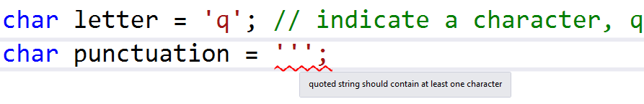

Why use these?
In some cases, characters need to serve multiple purposes
'
Take the single quote character (the apostrophe):
So… how to store a single-quote character?
It can’t be both an indicator of a character, and a character itself.
(How do you differentiate?)
char correct = '\'';
\' treats that as the character itself, not a part of C++ syntax
// Same for double-quotes
string quote = "He said \"Good morning\" to his neighbor.";
cout << quote << '\n'; // newline

Slide 18
Escape Sequences – You may not use them often
\n – Newline character
\\ - Backslash
\" – Double-quote
\t – Tab character
\' – Single-quote
\b - Backspace
\0 – NUL-terminator
These are the ones I personally encounter the most frequently

Slide 19
Backslash? Forward slash?
Depends on the OS
Linux/MacOS use forward slashes
Windows uses backslashes, but forward tends to work everywhere as well
Some programs/OS may recognize “wrong” slashes and convert
Others will just yell at you until you do it right
In this class, USE FORWARD SLASHES for every file path and you’ll be fine. That will work on MacOS, Linux, Windows, no problem!

Slide 20
File I/O
In C++, 3 classes will help with file input/output operations:
ofstream – Output file stream
ifstream – Input file stream
fstream – File stream (Input OR output [or both!] depending on what you need)

Slide 21
ofstream – Creating output files
#include <fstream> // Where file magic is located
using std::ofstream; // Or using namespace std; etc..
// Pass a string to its constructor to open
ofstream someFile("NameOfFile.txt");
/*==== OR ====*/
// Use the open function
ofstream someFile;
someFile.open("NameOfFile.txt");
// Do some stuff with said file

Slide 22
ofstream
Writing files is easy.
Use the insertion operator: <<
Just like printing something to the screen
Format your data any way that you want
Tabs? Use the '\t' character
Newline characters? '\n' (or endl)
etc

Slide 23
ofstream – Basic Usage
#include <fstream> // Where file magic is located
using std::ofstream; // Or using namespace std; etc..
ofstream someFile("NameOfFile.txt");
// Check if the file is actually open…
if (someFile.is_open())
{
// Write some data (just like using cout)
const float mmmPI = 3.1415f;
someFile << "Hello World, file edition.";
someFile << "Value of pi: " << mmmPI;
}
Contents of “NameOfFile.txt”
Hello World, file edition.Value of pi: 3.1415
Space or a newline might be helpful here…

Slide 24
ofstream – Basic Usage
ofstream someFile("Numbers.txt");
// Check if the file is actually open…
if (someFile.is_open())
{
for (int i = 2; i <= 16; i *=2)
someFile << i << endl;
// Close the file when finished // You MUST close it if you want to open another file, // using the SAME fstream object
someFile.close();
}
someFile.open("Numbers2.txt");
for (int i = 2; i <= 16; i *=2)
someFile << i << ' ';
Contents of “Numbers.txt”
2
4
8
16
Contents of “Numbers2.txt”
2 4 8 16

Slide 25
ifstream – Reading Files
What if there are more (or fewer) than 4 values in the file?
ifstream file(“Numbers.txt");
vector<int> numbers;
if (file.is_open())
{
int value;
for (int i = 0; i < 4; i++)
{
file >> value;
cout << value; // Print
numbers.push_back(value); // Or store
}
}
Contents of “Numbers.txt”
2
4
8
16
This just gets you the value. What you do with it is up to you.

Slide 26
ifstream – Reading the entire file
ifstream file(“Numbers.txt");
int value;
// While something is read successfully
while (file >> value)
{
cout << value;
}
Contents of “Numbers.txt”
2
4
8
16
After reading a value, >> returns the stream, which is then checked for validity
True if everything is a-ok, value was read, no file errors, etc… false otherwise

Slide 27
What about closing files?
Do you NEED to call .close() on an object?
For the most part, no—the destructors of file stream objects call close automatically for you
This is part of a concept called Resource Acquisition Is Initialization, or RAII
When an object is initialized it handles the acquisition of some resource (a file, in this case)
When that object is destroyed, it handles freeing that resource
As long as the object is around, the resource is valid
If you do call close()? Nothing bad will happen
I often do it out of habit with other languages
Not all programming languages are like this! In C#, for example, you MUST close files when you are done using them

Slide 28
Clean up before reuse
If you intend to reuse an object…
A single variable could be used to open multiple files over a function or program’s lifetime
Currently open files must be closed before you can open another
ofstream file;
file.open("Example1.txt"); // Creates a file
file.close();
file.open("Example2.txt"); // Creates a file, the previous was closed
file.open("Example3.txt"); // Fails to create/open a file
file.open("Example4.txt"); // Fails to create/open a file

Slide 29
What about multiple types of data?
A loop through homogenous values is one thing
What if the file was something like this:
// 1. Open file
ifstream file("cars.txt");
// 2. Create some storage
string make;
string model;
int mileage;
float price;
// 3. Read some data
file >> make;
file >> model;
file >> mileage;
file >> price;
“Cars.txt”
Format of car data:
Make (string)
Model (string)
Mileage (int)
Price (float)
Ford
Mustang
14231
28147.39
Tesla
Model 3
79
46212.41
How might you read that data?
What about the 2nd car?

Slide 30
More than one group of data? Easy!
// 1. Open file
ifstream file("cars.txt");
// 2. Create some storage
string make;
string model;
int mileage;
float price;
// 3. Read some data
file >> make;
file >> model;
file >> mileage;
file >> price;
// 1. Open file
ifstream file("cars.txt");
// 2. Create some storage
string make;
string model;
int mileage;
float price;
// 3. Read some data
file >> make;
file >> model;
file >> mileage;
file >> price;
// 4. Easy!
file >> make;
file >> model;
file >> mileage;
file >> price;
Perhaps an array?
Maybe some class object(s) to store this?
Well, yeah… technically that would work, but…

Slide 31
Perhaps a loop of some sort?
for (int i = 0; i < numberOfCarsInFile; i++)
{
file >> make;
file >> model;
file >> mileage;
file >> price;
}
Where does this number come from?
Total number of lines read? Divided by number of lines per object…?
That’s a little clumsy…
“Cars.txt”
How about changing the file format?
“Cars.txt”
Ford
Mustang
14231
28147.39
Tesla
Model 3
79
46212.41
2
Ford
Mustang
14231
28147.39
Tesla
Model 3
79
46212.41
Store the number of things in the file itself

Slide 32
Files can contain data about other data
// 1. Read the number at the start of the file
int carCount;
file >> carCount;
// 2. For "carCount" cars, read each one--4 data elements apiece
// Why 4? Because that's how THIS file is structured
for (int i = 0; i < carCount; i++)
{
// 3 (or 2a. whichever) Read data for a single object
file >> make;
file >> model;
file >> mileage;
file >> price;
// 4. Create an object, store it somewhere, etc.
Car sweetRide(make, model, mileage, price);
someVectorOfCars.push_back(sweetRide);
}
Reading data requires some knowledge of the format of the file (a file header, the “objects” in the file)
Every file could be different
This format may change, in which case your code could be broken, and in need of updating

Slide 33
Data organization
Homogenous lists
Interleaved data types on separate lines
Data on the same line, separated by a delimiter
141
2834
2354
718
59981
67120
563
2344
2
Ford
Mustang
14231
28147.39
Tesla
Model 3
79
46212.41
Ford Mustang 14231 28147.39
Dodge Neon 23429 12212.41
Ford,Mustang,14231,28147.39
Dodge,Neon,23429,12212.41
Ford|Mustang|14231|28147.39
Dodge|Neon|23429|12212.41
One line, one value
Multiple lines to make one object
One line, one object… but in multiple pieces

Slide 34
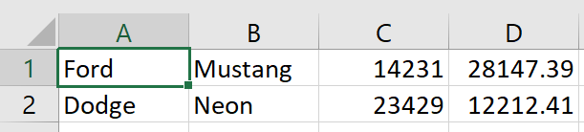

Comma Separated Values (CSV) file
A CSV file is a very common text-based format to store information
The information is separated by using a comma as a delimiter
CSV is often used as a “generic” format for spreadsheets
Data in Excel
Many spreadsheet programs will read .CSV data and use commas to split data into cells
The same data in a text editor, as a .CSV file
One line from a file: one row
Each token (data separated by a delimiter): a column

Slide 35
Multiple values on a single line - getline
Stream could be a file (some ifstream object), or some other source of data, like an istringstream.
// Get one line at a time from a STREAM.
getline(stream, buffer, delimiter(optional))
/*
[stream] where the data is coming from
[buffer] where to store the data
[delimiter] read until you find to this character
*/

Slide 36
Reading an entire file, line by line
// Basic file reading... Line by line, until it's done.
ifstream file(“SomeRandomFile.txt");
if (file.is_open())
{
string line;
// While there is a line to be gotten
while (getline(file, line))
cout << line << endl;
}

Slide 37
What about only part of a line?
/*open the file, is_open() yadda yadda…*/
ifstream file("whateverfile.ext");
string line;
// While there is data to be gotten…
// Get PART OF IT, by using a delimiter.
while (getline(file, line, ' '))
{
// Print out one name at a time
cout << line << endl;
}
Contents of “SomeRandomFile.txt”
Batman Robin Alfred Batgirl Joker Two-Face
Read until you find this character, then stop.
So this will first read “Batman”
The next call will read “Robin”, etc…

Slide 38
Delimiters
A character used to indicate some stopping point or boundary between parts of a stream of data
Can be anything you want
Common delimiters
Spaces
Commas
Pipe symbol / vertical bar:
Used to break data into separate tokens
This is a good delimiter because it is rarely used as part of the data itself
|

Slide 39
Delimiters can be anything you want
Batman,Robin,Batgirl,Joker,Two-Face,Killer Croc
Batman|Robin|Batgirl|Joker|Two-Face|Killer Croc
Batman$Robin$Batgirl$Joker$Two-Face$Killer Croc
Batman%Robin%Batgirl%Joker%Two-Face%Killer Croc
BatmanQRobinQBatgirlQJokerQTwo-FaceQKiller Croc
Batman Robin Batgirl Joker Two-Face Killer Croc
Some characters are better choices than others…
Spaces… bad choice if your data has spaces in it
Now Batman has to fight “Killer” AND “Croc”

Slide 40
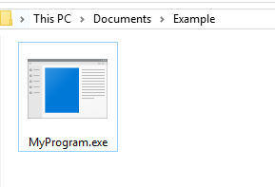
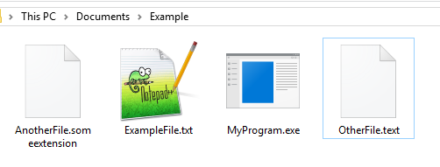
Where are files created (or read from)?
By default, the same directory as your program (your executable)
int main()
{
ofstream outFile("ExampleFile.txt");
ofstream outFile2("OtherFile.text");
ofstream outFile3("AnotherFile.someextension");
return 0;
}

Slide 41
Follow-up question? Where is the executable?
If you’re building your code in an IDE… that depends
Every IDE has different settings, settings that you could change
It may be in a Debug/Release folder
You may direct the output to "C:/AllMyProgramsGoHere"
If you’re building with the command-line, probably where you just built it (more on this later)

Slide 42
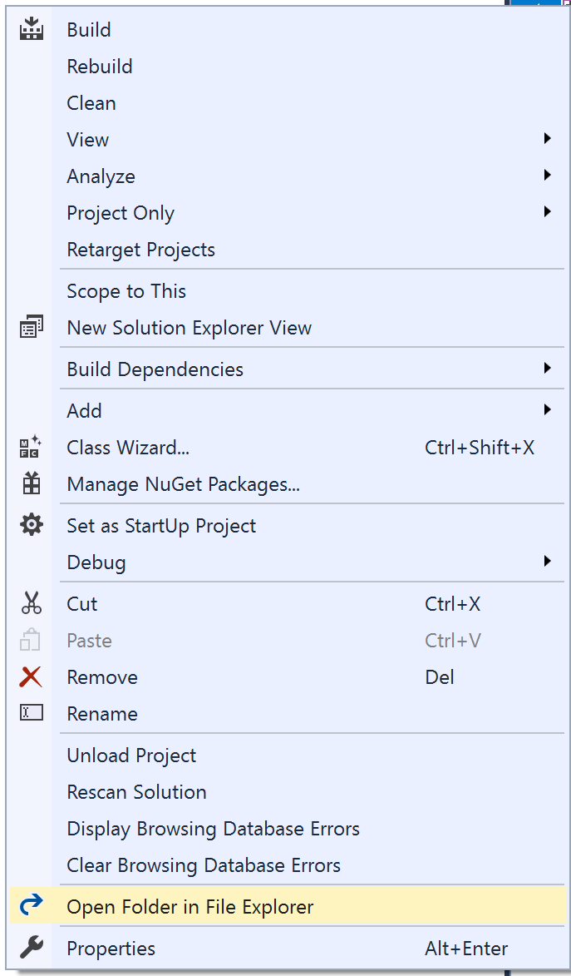
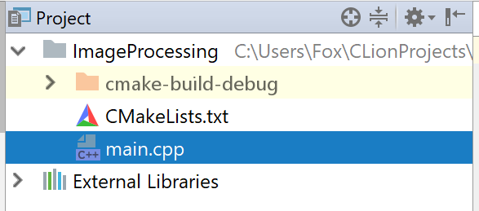
Where does my IDE read/write files?
Visual Studio
Depends on the IDE—for example, by default:
Visual Studio – looks in the same folder as your source code (right-click on your project in Solution Explorer, then select “Open Folder in File Explorer”)
Clion – External files are read from the cmake-build-debug directory
CLion
Your code is in this folder
External files are in THIS folder
Your code AND external files are in this folder (by default)

Slide 43
Should you change your code to adapt to your IDE?
No
Never
Really, don’t
Change your IDE settings, or move directories/files around if needed
Your code should work in as many situations as possible
Image code that looks like this…
if (Code is on Sarah’s Machine)
file.open(“C:/Sarah/Documents/file.txt”
else if (running on Bob’s machine)
file.open(“C:/Documents/Magical Stuff/Unicorns/file.txt”

Slide 44
Absolute Paths vs Relative Paths
An absolute path is a fixed, unchanging path – this is good if you know, without a doubt, the location will never change
A relative path is relative to some other location – this could be the executable (by default), or from some other starting point
Absolute Paths
Relative Paths
"C:/ThisFolder/SubFolder/someFile.txt"
"F:/User/Documents/data/results.xyz"
"C:/Bob/School/Courses/COP3503/Lab1.cpp"
"someFile.txt"
"data/results.xyz"
"COP3503/Lab1.cpp"
These are fine if you never intend for any of this to change
From the location of the program…
If your program runs on someone else’s machine, however…
If your program runs on someone else’s machine, however…

Slide 45
IO modes – enum values from ios_base
Alternate ways of opening files – different flags for different purposes
ios_base::in – Input
ios_base::out – output
ios_base::app – append, seek to the end after every write
ios_base::ate – Seek to the end after opening (At The End)
ios_base::trunc – Truncate the file (delete its contents)
ios_base::binary – Perform operations in binary mode
Binary file operations are a whole different beast… more on that later
fstream someFile("file.ext", ios_base::out | ios_base::binary | ios_base::app);
Combine multiple options using the bitwise OR operator – open this file in output mode, binary mode, AND write to the end every time

Slide 46
Recap
Simple programs might contain all the data they need, or get it from user input
Sometimes data needs to persist
Nearly every program has some form of file saving/loading
The overall process is generally the same:
Open a file, read some data, then use that data in your program
Take some or all of the data from a program, write that out to a file for some later purpose

